Slide 1

car price prediction

Slide 2
Problem statement
Anyone who has booked a flight ticket knows how unexpectedly the prices vary. The cheapest available ticket on a given flight gets more and less expensive over time. This usually happens as an attempt to maximize revenue based on -
1. Time of purchase patterns (making sure last-minute purchases are expensive)
2. Keeping the flight as full as they want it (raising prices on a flight which is filling up in order to reduce sales and hold back
inventory for those expensive Last minute expensive purchases.
So, you have to work on a project where you collect data of flight fares with other features and work to make a model to predict fares of flights.

Slide 3
The Purpose is to Predict CAR PRICE PREDICTION We trained 4 models, which are proven to be effective, to PREDICT FLIGHT PRICE based on information
FLIGHT NAME
GRADIENT BOOSTING
BAGGING
DECISION TREE
XGB
DEPARTURE TIME
Output Variable:
LABEL
ARRIVAL TIME
NO OF STOPS
R-2 SCORE
-
CROSS VALIDATION SCORE
SOURCE
DESTINATION
BEST MODEL
DATE

Slide 4
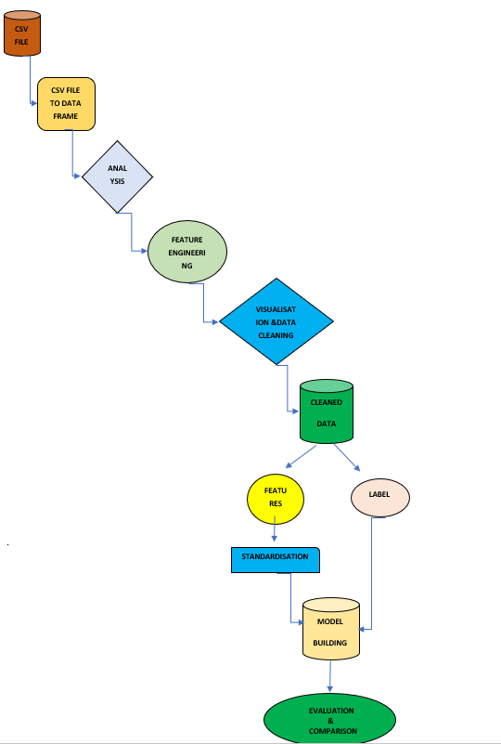
Architecture HERE WE DESCRIBE THE STEPS INVOLVED IN BUILDING MODEL
With the help of flow chart I sum up all the necessary steps
that are used in building machine learning models.

Slide 5
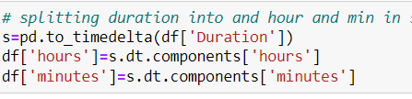
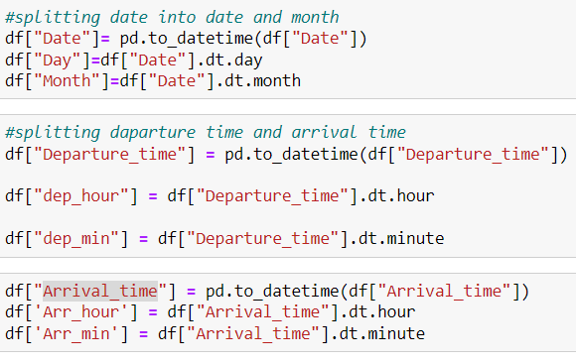
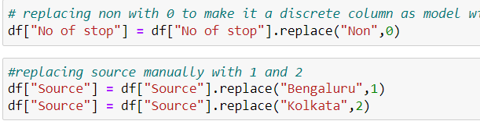
imputation of dataset
Time delta
encoding
Feature engineering

Slide 6
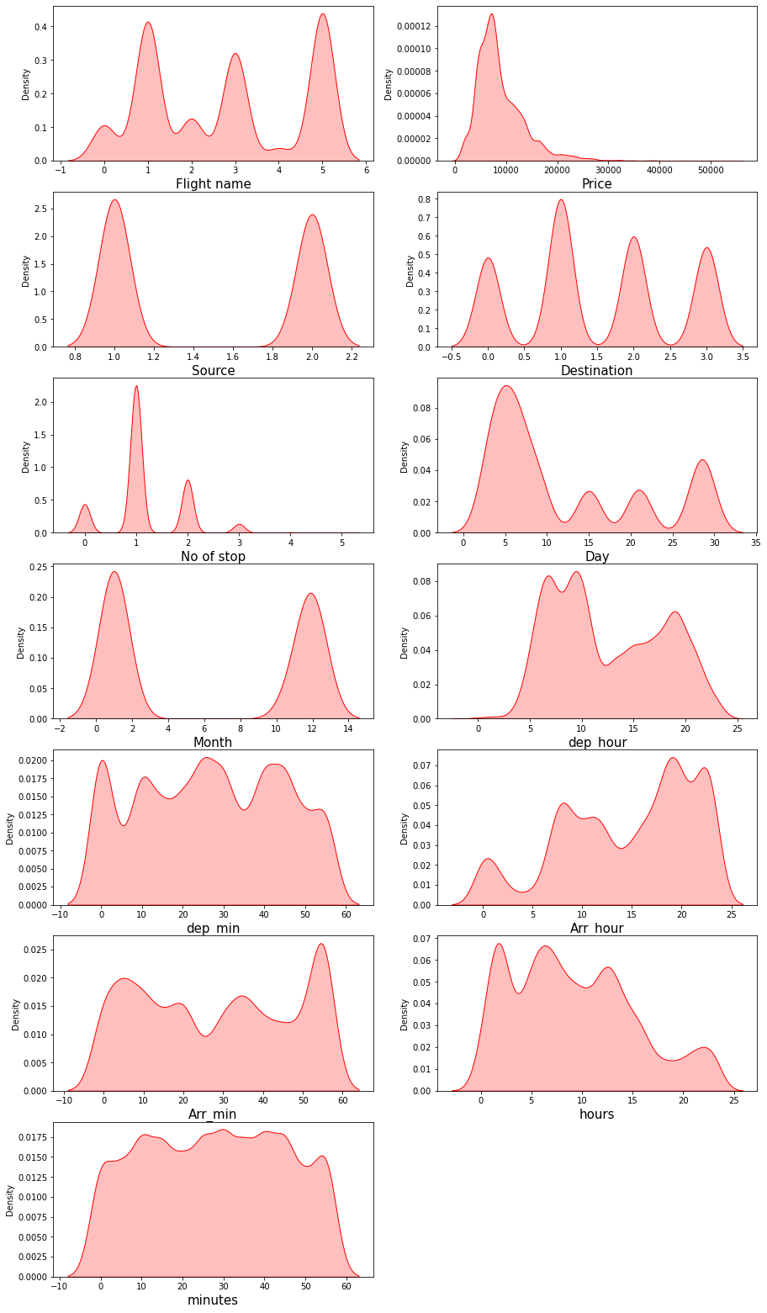
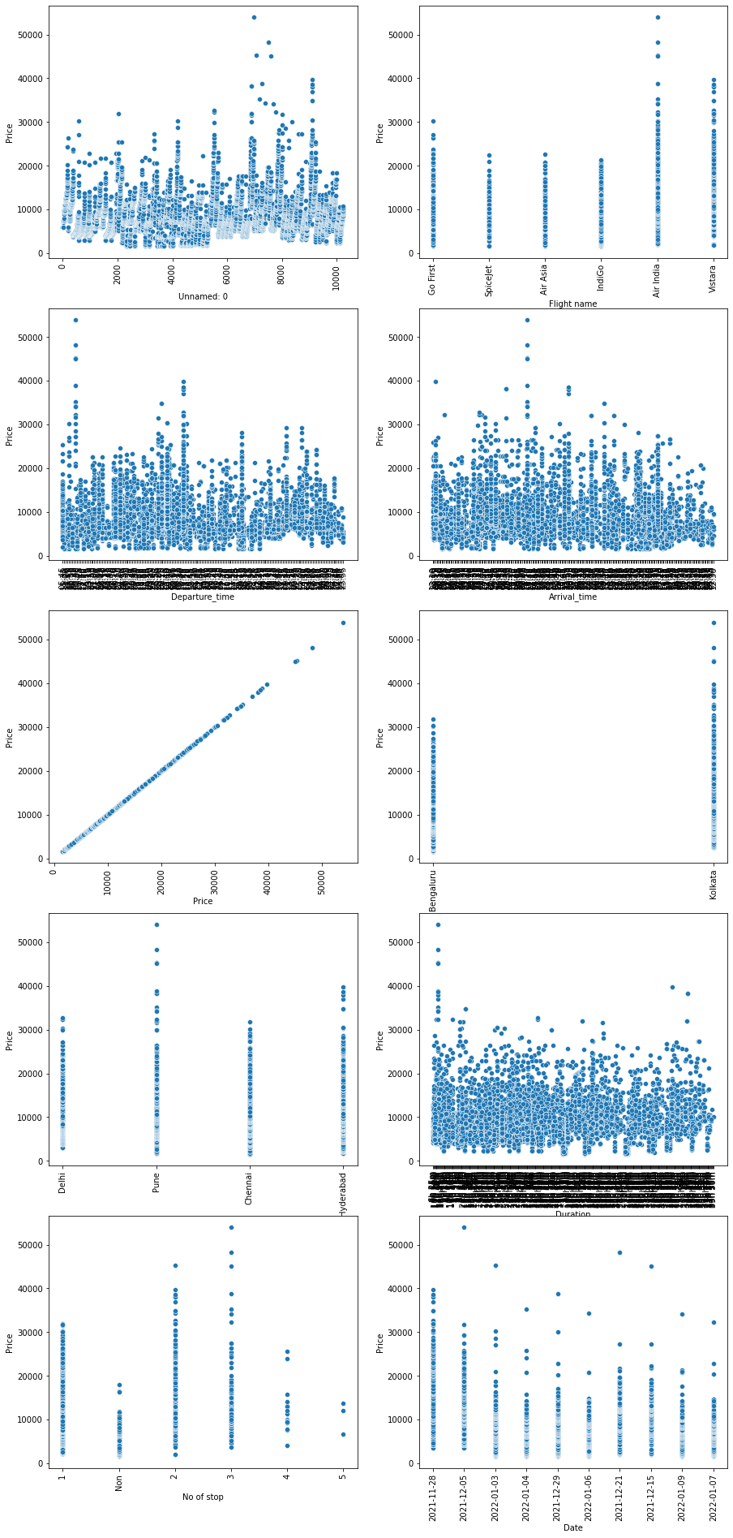
A glance of dataset ExploratiNG dataset is the foundation of the following pre-processing and modeling
Distributions of variables
Relationship between input and output variables
Some variables are significantly skewed that might need to be standardized
Outliers exist and some variables have strong linear relationship with price

Slide 7
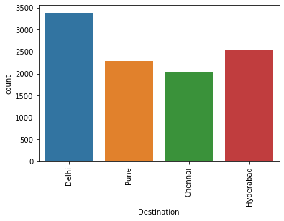
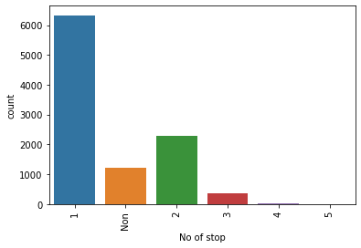
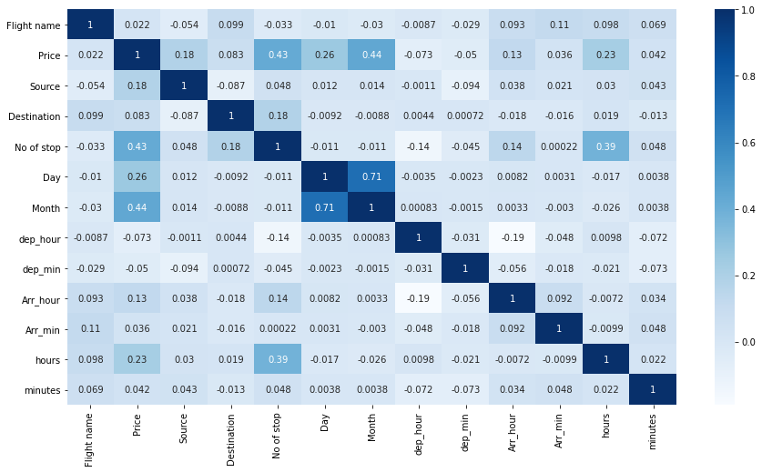
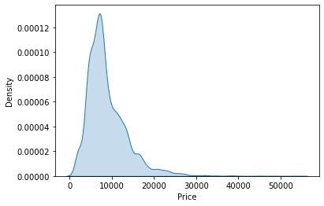
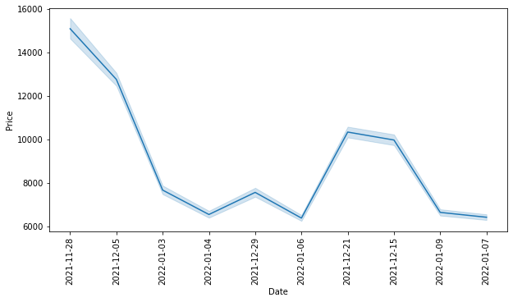
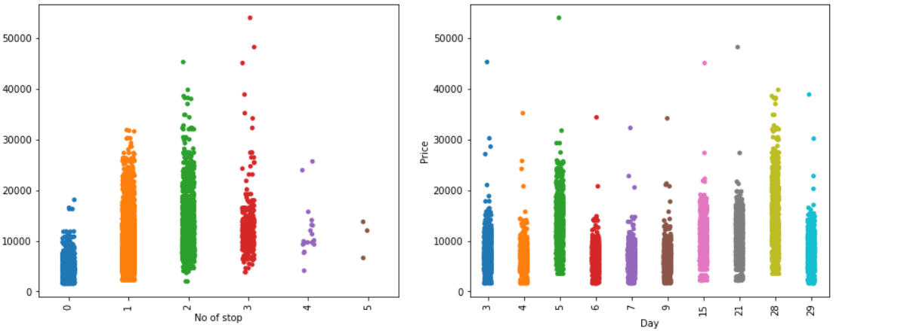
Analysis univariate, bivariate, multivariate analysis to study relationship
Univariate
Multivariate
Bivariate

Slide 8
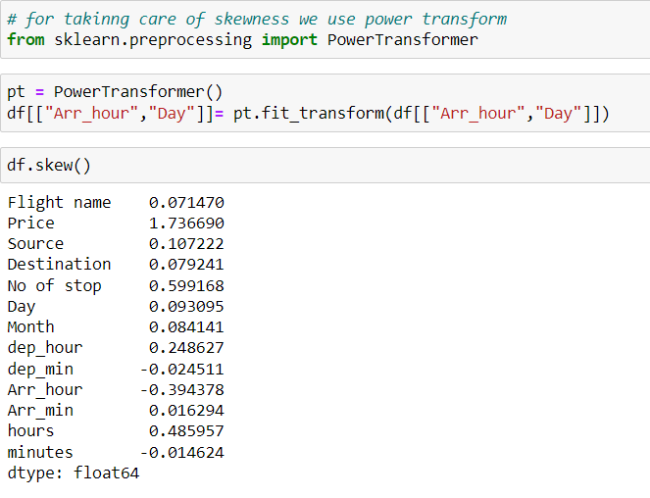
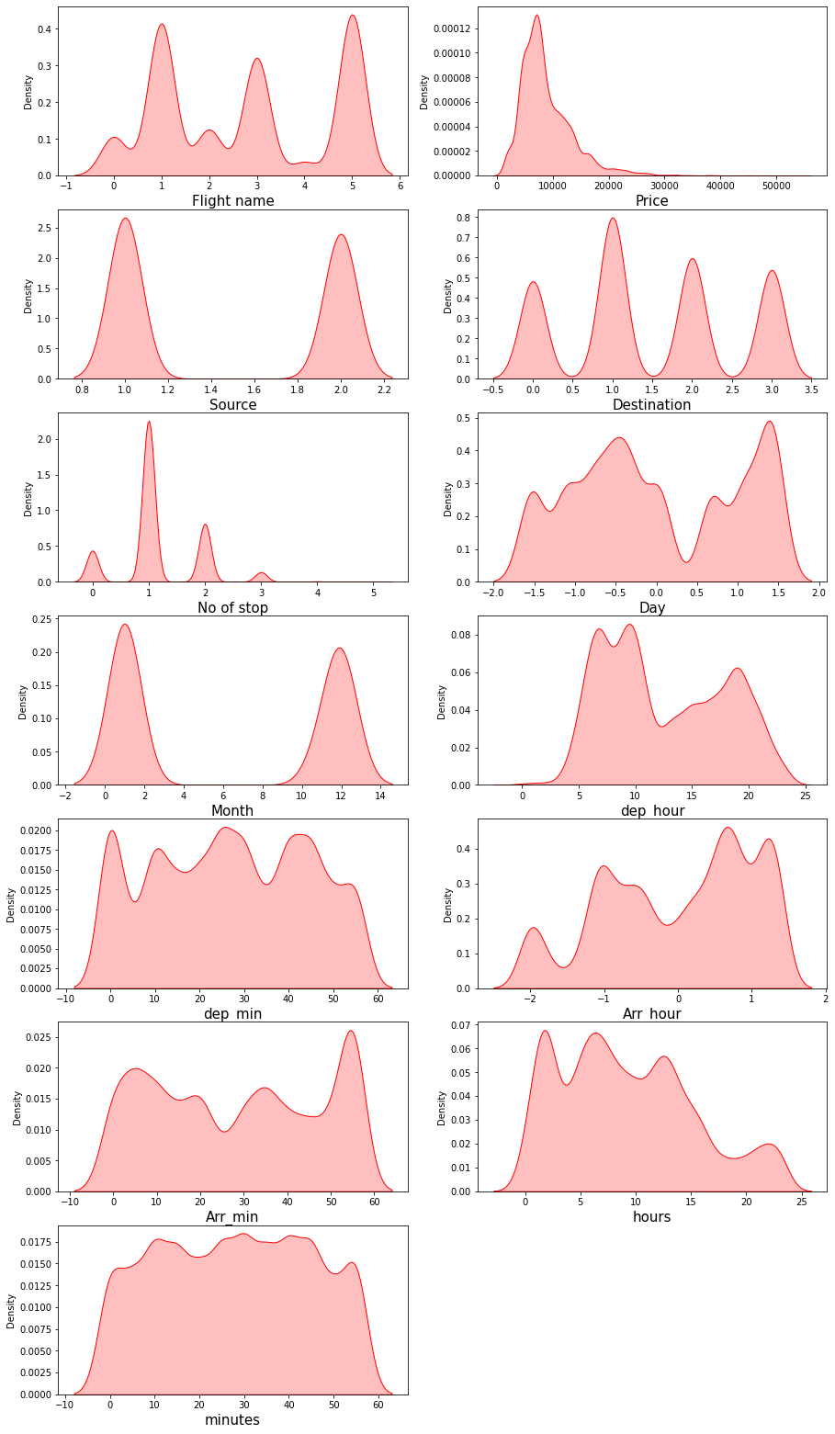
Removing skewness of Important - Highly Correlated – Features removing skewness in important features that have high correlation with Price .
Using power transformer to remove skewness in the dataset.
There is skewness present in target column but we don’t remove the skewness of target column as it is not a good practice also no of stop is categorical column.

Slide 9


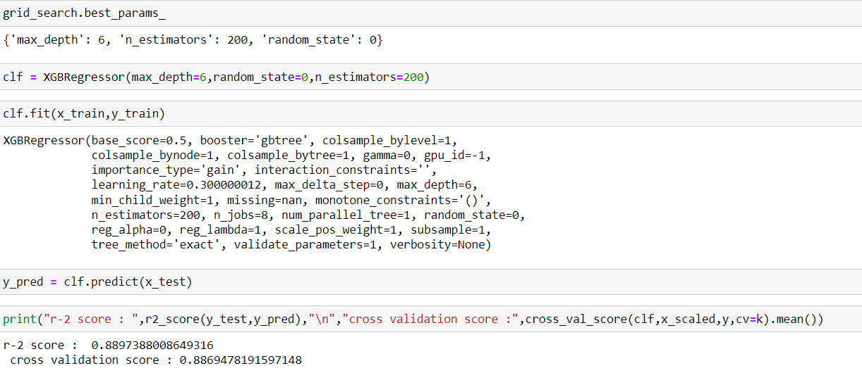

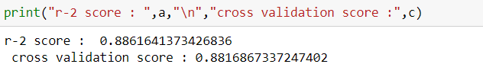
Price Prediction by different model Model comparison and price prediction
MODEL
GRADIENT BOOSTING
HYPER PARAMETER
TUNING
BAGGING
XGB
DECISION TREE
XGB REGRESSION

Slide 10
RESULT
Many machine learning algorithms are used to predict. However, the prediction accuracy of these algorithms depends heavily on the given data when training the model. If the data is in bad shape, the model will be overfitted and inefficient, which means that data pre-processing is an important part of this experiment and will affect the final results. Thus, multiple combinations of pre-processing methods need to be tested before getting the data ready to be used in training. After analyzing every model XGB Regressor shows good accuracy and cv with least difference and on doing hyper parameter tuning it accuracy reaches to 89%. If we compare the flight prices of the month of January, we can see that price of the flight changes frequently near the date of november. The flight prices increase in large increments near the departure dates. But increases and decreases in very small increments afterwards. Similarly, if we compare the flight prices in the month of November and December, we can see that flight prices increases. Therefore, we concluded that the flight prices tend to decrease over time, sometimes they show sudden increases but most of the time they tend to decrease

Slide 11
CONCLUSION
Flight price prediction can be a challenging task due to the high number of attributes that should be considered for the accurate prediction. The major step in the prediction process is collection and preprocessing of the data which we have successfully done using different machine learning algorithms like a Decision tree, Bagging, Gradient Boosting and XGB so it’s clear that XGB have more accuracy in prediction when compared to the others and also my research provides to find the attributes contribution in prediction. So, I would believe this research will be helpful for both the company and people, the future works are stated below Every system and new software technology can help in the future to predict the prices. Although, this model has achieved astonishing performance in flight price prediction problem our aim for the future research is to test this model to work successfully with various data sets.

